Slide 1


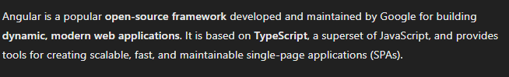
Angular
By Eslam Khder

Slide 2
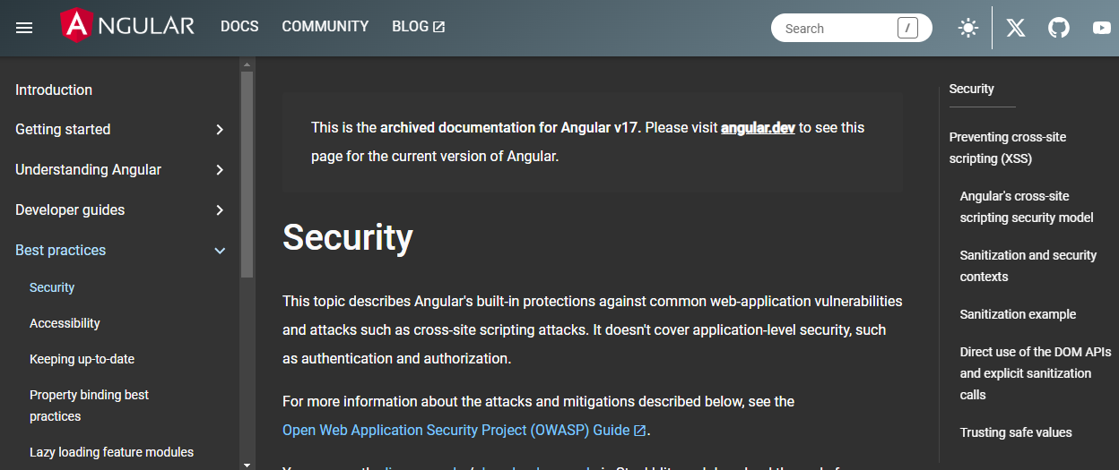
By Eslam Khder

Slide 3



we need node js 16
nvm-setup.exe
https://sourceforge.net/projects/nvm-for-windows.mirror/
By Eslam Khder

Slide 4

Web Storm tools
https://www.jetbrains.com/webstorm/download/#section=windows
By Eslam Khder

Slide 5
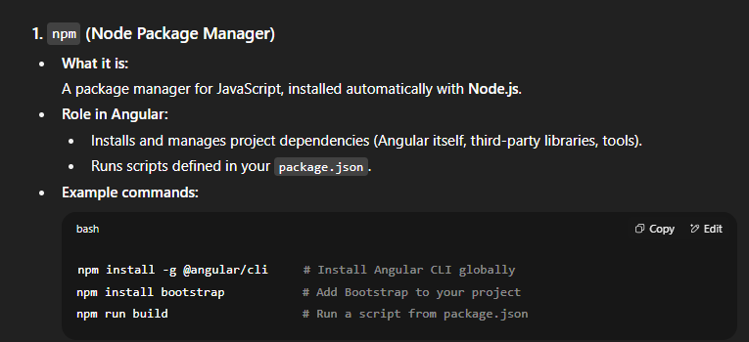
By Eslam Khder

Slide 6
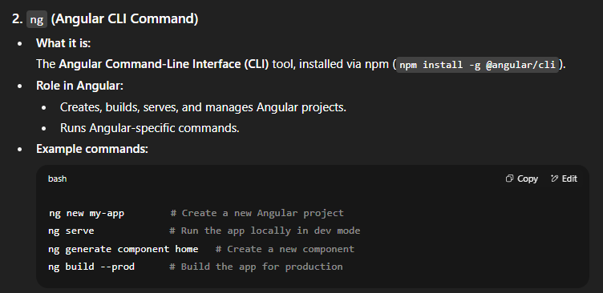
By Eslam Khder

